Slide 1
Process Synchronization

Slide 2
Background
Concurrent access to shared data may result in data inconsistency
Maintaining data consistency requires mechanisms to ensure the orderly execution of cooperating processes
Process Synchronization is a way to coordinate processes that use shared data. It occurs in an operating system among cooperating processes.
Cooperating processes are processes that share resources. While executing many concurrent processes, process synchronization helps to maintain shared data consistency and cooperating process execution.
Processes have to be scheduled to ensure that concurrent access to shared data does not create inconsistencies. Data inconsistency can result in what is called a race condition.
A race condition occurs when two or more operations are executed at the same time, not scheduled in the proper sequence, and not exited in the critical section correctly.

Slide 3
Race Condition
The statements
        counter++;
        counter--;
must be performed atomically.
Atomic operation means an operation that completes in its entirety without interruption.
The statement “count++” may be implemented in machine language as:
register1 = counter
register1 = register1 + 1
counter = register1
The statement “count—” may be implemented as:
register2 = counter
register2 = register2 – 1
counter = register2

Slide 4
Race Condition
Consider this execution interleaving with “count = 5” initially:
  S0: producer execute register1 = count {register1 = 5}
  S1: producer execute register1 = register1 + 1 {register1 = 6}
  S2: consumer execute register2 = count {register2 = 5}
  S3: consumer execute register2 = register2 - 1 {register2 = 4}
  S4: producer execute count = register1 {count = 6 }
  S5: consumer execute count = register2 {count = 4}
Race condition: The situation where several processes access – and manipulate shared data concurrently. The final value of the shared data depends upon which process finishes last.
To prevent race conditions, concurrent processes must be synchronized.

Slide 5
Critical Section Problem
Consider system of n processes {p0, p1, … pn-1}
Each process has critical section segment of code
Process may be changing common variables, updating table, writing file, etc
When one process in critical section, no other may be in its critical section
Critical section problem is to design protocol to solve this
Each process must ask permission to enter critical section in entry section, may follow critical section with exit section, then remainder section
Critical section is a code segment that can be accessed by only one process at a time.
Critical section contains shared variables which need to be synchronized to maintain consistency of data variables.

Slide 6
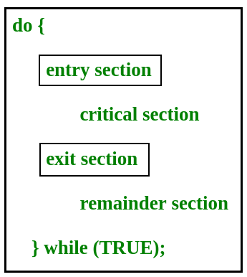
Critical Section Problem

Slide 7
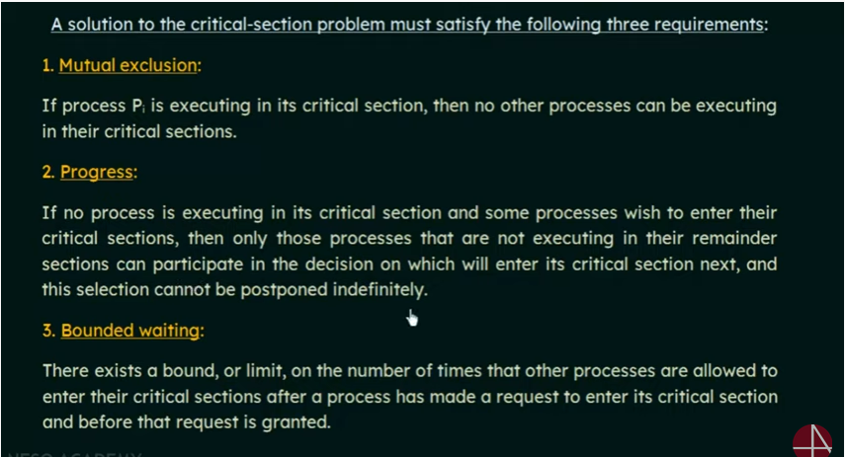
Critical-Section Problem & Solution to Critical-Section Problem
  No assumption related to hardware. Assume that each process executes at a nonzero speed
  No assumption concerning relative speed of the N processes

Slide 8
Initial Attempts to Solve Problem
Only 2 processes, P₀ and P₁
General structure of process P_{i} (other process P_{j})
do {
entry section
critical section
exit section
reminder section
} while (1);
Processes may share some common variables to synchronize their actions.

Slide 9
Algorithm 1 & 2 : The initial FAIL attempts
First Attempt
Shared variables:
  int turn;
  initially turn = 0
  turn = i ⇒ P_{i} can enter its critical section
Process P_{i}
      do {
      while (turn != i) ;
      critical section
      turn = j;
      reminder section
      } while (1);
Satisfies mutual exclusion, but not progress
Second Attempt
Shared variables
  boolean flag[2];
  initially flag [0] = flag [1] = false.
  flag [i] = true ⇒ P_{i} ready to enter its critical section
Process P_{i}
      do {
      flag[i] := true;
      while (flag[j]==true) ;
      critical section
      flag [i] = false;
      remainder section
      } while (1);
Satisfies mutual exclusion, but not progress requirement.

Slide 10
Algorithm 3: The CORRECT approach
Combined shared variables of algorithms 1 and 2.
Meets all three requirements; solves the critical-section problem for two processes.
This algorithm is also called as PETERSON’s Solution

Slide 11
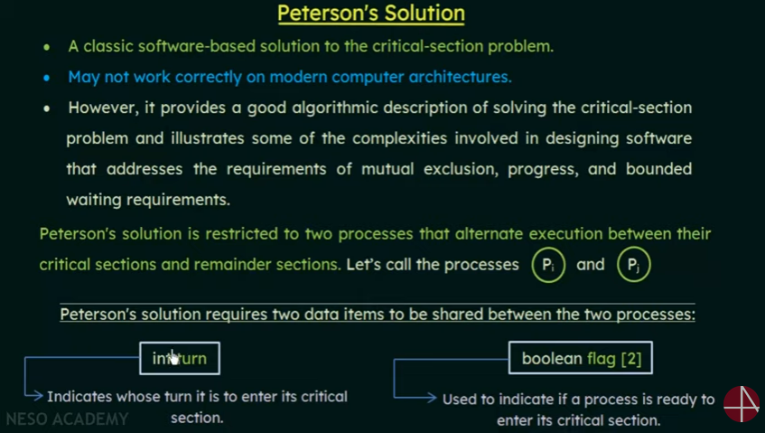

Slide 12
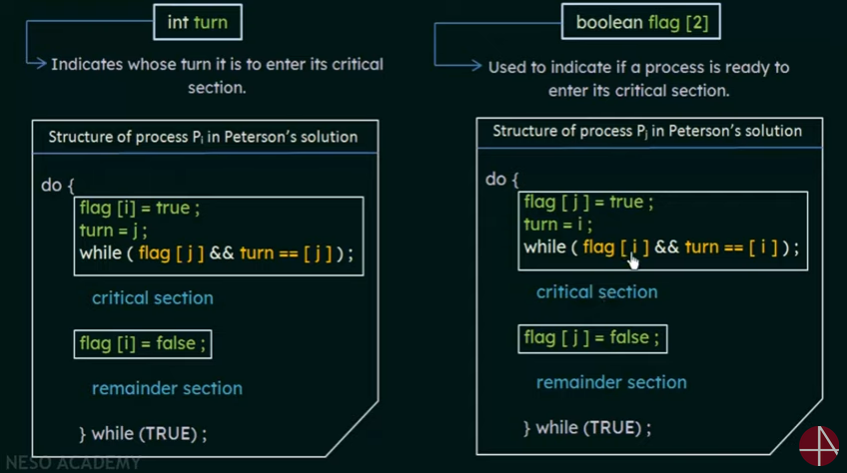

Slide 13
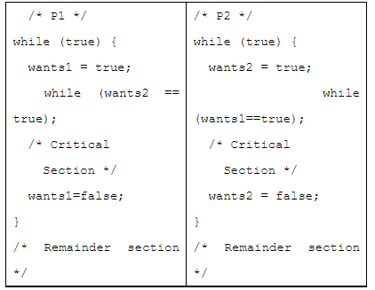
Question 5:
Two processes, P1 and P2, need to access a critical section of code. Consider the following synchronization construct used by the processes:
Here, wants1 and wants2 are shared variables, which are initialized to false. Which one of the following statements is TRUE about the above construct?
(a) It does not ensure mutual exclusion.
(b) It does not ensure bounded waiting.
(c) It requires that processes enter the critical section in strict alternation.
(d) It does not prevent deadlocks, but ensures mutual exclusion.

